Slide 1
2D Graphics Introduction
Dr. Lathsamy Chidtavong
Mobile No.77712077
Email: l.chidtavong@nuol.edu.la
Link: https://www.w3schools.com/graphics/svg_rect.asp

Slide 2
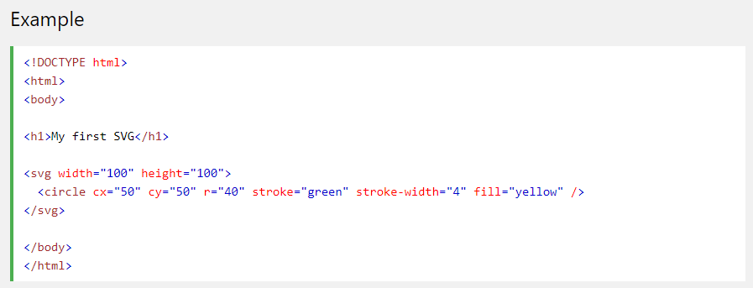
SVG in HTML
Embed SVG Directly Into HTML Pages

Slide 3
SVG in HTML
An SVG image begins with an <svg> element
The width and height attributes of the <svg> element define the width and height of the SVG image
The <circle> element is used to draw a circle
The cx and cy attributes define the x and y coordinates of the center of the circle. If cx and cy are not set, the circle's center is set to (0, 0)
The r attribute defines the radius of the circle
The stroke and stroke-width attributes control how the outline of a shape appears. We set the outline of the circle to a 4px green "border"
The fill attribute refers to the color inside the circle. We set the fill color to yellow
The closing </svg> tag closes the SVG image

Slide 4
SVG Shapes
SVG has some predefined shape elements that can be used by developers:
Rectangle <rect>
Circle <circle>
Ellipse <ellipse>
Line <line>
Polyline <polyline>
Polygon <polygon>
Path <path>

Slide 5
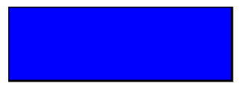
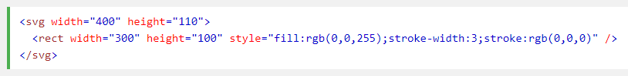
SVG Shapes
SVG Rectangle - <rect>
The <rect> element is used to create a rectangle and variations of a rectangle shape:

Slide 6
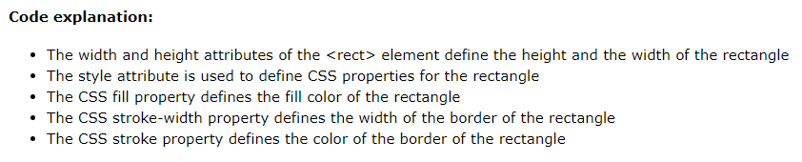
SVG Shapes

Slide 7
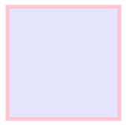
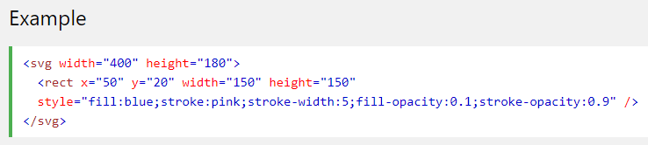
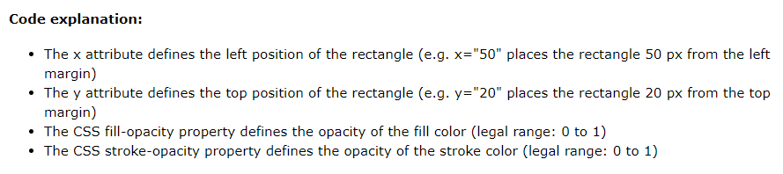
SVG Shapes

Slide 8
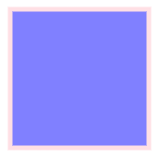
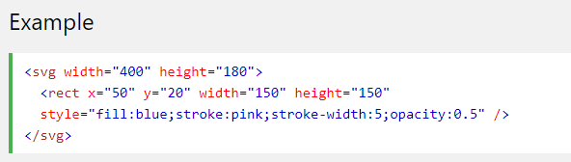

SVG Shapes

Slide 9
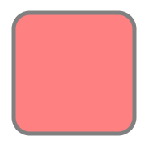
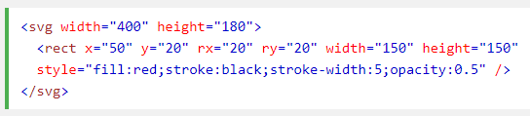

SVG Shapes

Slide 10
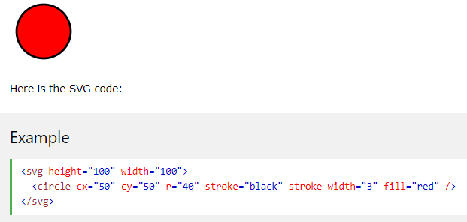
SVG Shapes
SVG Circle - <circle>
The <circle> element is used to create a circle:
Code explanation:
The cx and cy attributes define the x and y coordinates of the center of the circle. If cx and cy are omitted, the circle's center is set to (0,0)
The r attribute defines the radius of the circle

Slide 11
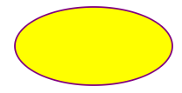
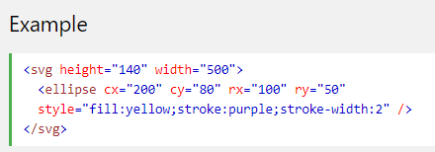
SVG Shapes
SVG Ellipse - <ellipse>
The <ellipse> element is used to create an ellipse.
An ellipse is closely related to a circle. The difference is that an ellipse has an x and a y radius that differs from each other, while a circle has equal x and y radius:

Slide 12
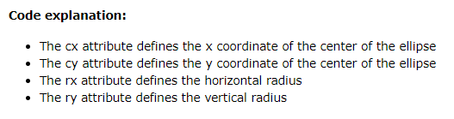
SVG Ellipse - <ellipse>

Slide 13
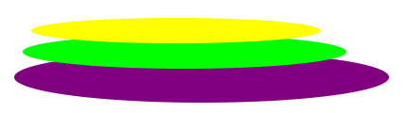
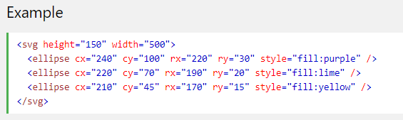
SVG Ellipse - <ellipse>

Slide 14
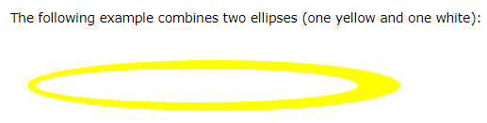
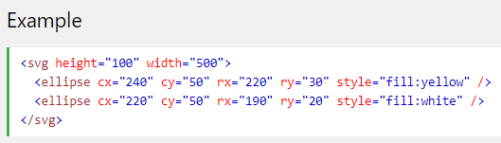
SVG Ellipse - <ellipse>

Slide 15
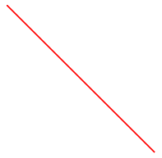
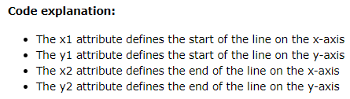
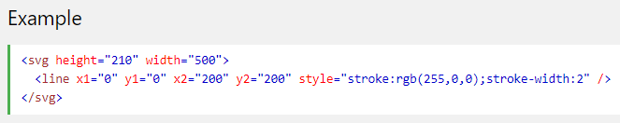
SVG Line - <line>
The <line> element is used to create a line

Slide 16
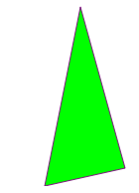
SVG <polygon>
The <polygon> element is used to create a graphic that contains at least three sides.
Polygons are made of straight lines, and the shape is "closed" (all the lines connect up).

Slide 17
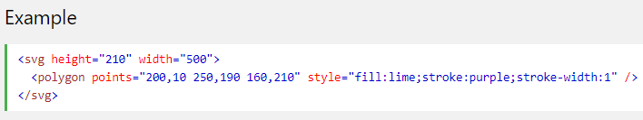
SVG <polygon>

Slide 18
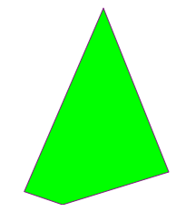
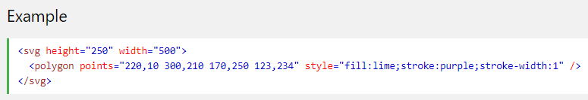
SVG <polygon>

Slide 19
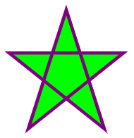
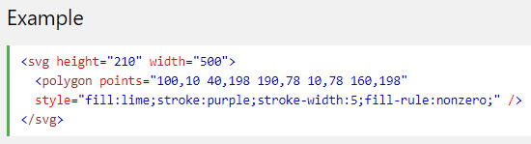
SVG <polygon>

Slide 20
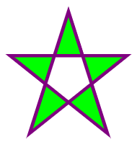
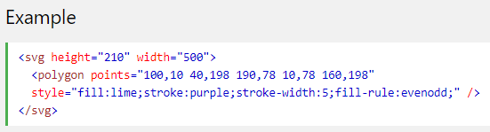
SVG <polygon>

Slide 21
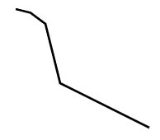
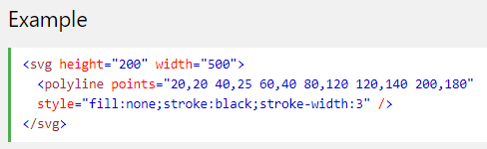
SVG Polyline - <polyline>
The <polyline> element is used to create any shape that consists of only straight lines (that is connected at several points):

Slide 22
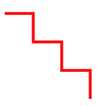
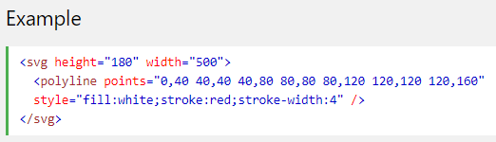
SVG Polyline - <polyline>

Slide 23
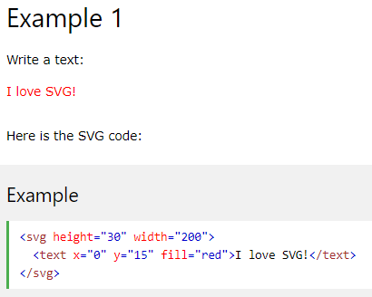
SVG <text>
The <text> element is used to define a text.

Slide 24
SVG <text>
The <text> element is used to define a text.

Slide 25
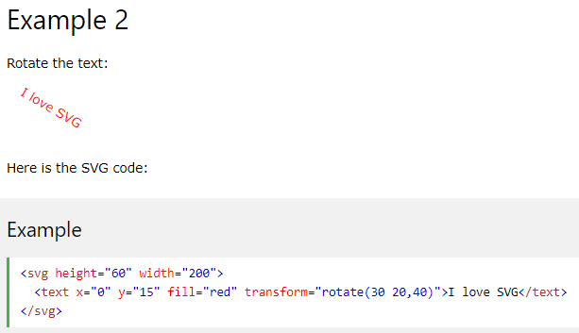
SVG <text>

Slide 26
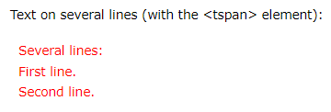
SVG <text>
The <text> element can be arranged in any number of sub-groups with the <tspan> element.
Each <tspan> element can contain different formatting and position.

Slide 27
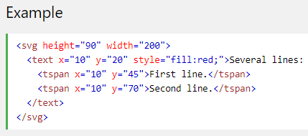
SVG <text>

Slide 28

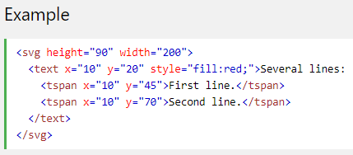
SVG <text>

Slide 29
SVG Stroke Properties
SVG offers a wide range of stroke properties. In this chapter we will look at the following:
stroke
stroke-width
stroke-linecap
stroke-dasharray
All the stroke properties can be applied to any kind of lines, text and outlines of elements like a circle.

Slide 30

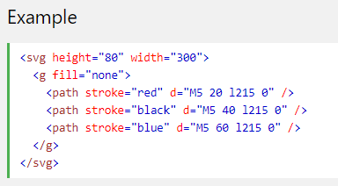
SVG Stroke Properties

Slide 31

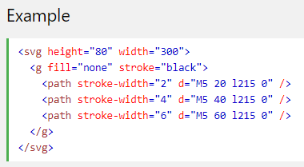
SVG stroke-width Property

Slide 32

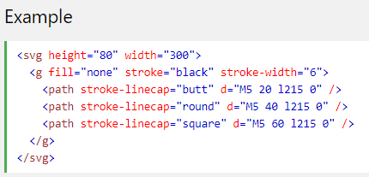
SVG stroke-linecap Property

Slide 33

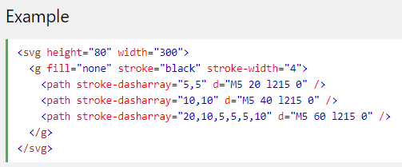
SVG stroke-dasharray Property

